Slide 1
QUALYS DEMO – SECURITY HARDENING
Lets have a look at how Qualys can aid in the security hardening process

Slide 2
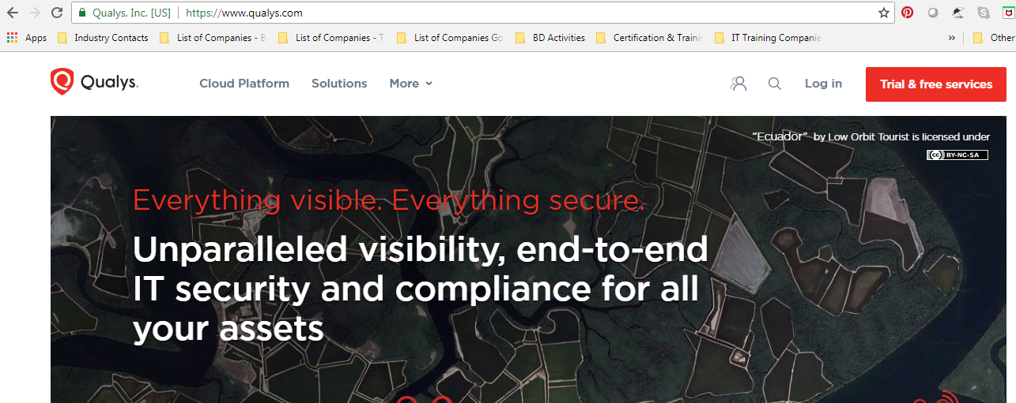
QUALYS DEMO – SECURITY HARDENING
QUALYS WEBSITE – FREE TRIAL

Slide 3
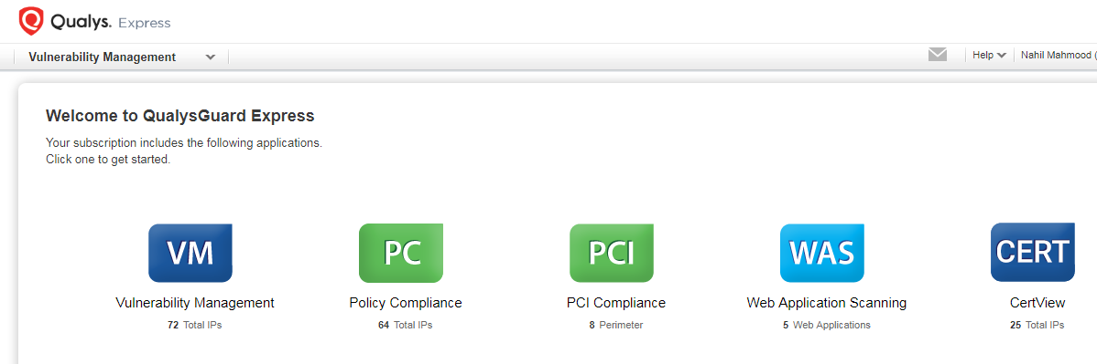
QUALYS DEMO – SECURITY HARDENING
QUALYS GUARD – HOME SCREEN

Slide 4
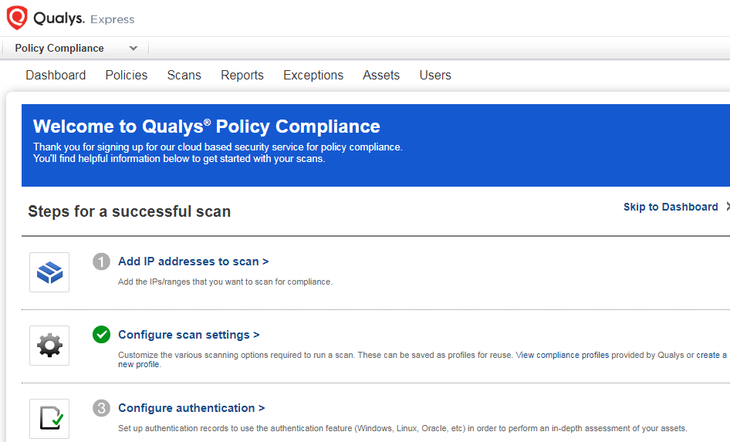
QUALYS DEMO – SECURITY HARDENING
POLICY COMPLIANCE – HOME SCREEN

Slide 5
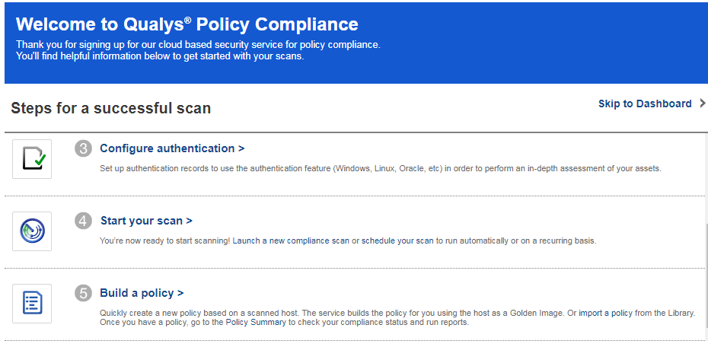
QUALYS DEMO – SECURITY HARDENING
POLICY COMPLIANCE – 5 STEPS

Slide 6
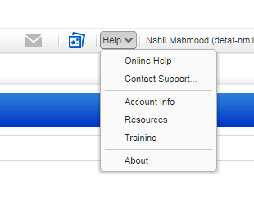
QUALYS DEMO – SECURITY HARDENING
HELP OPTIONS

Slide 7
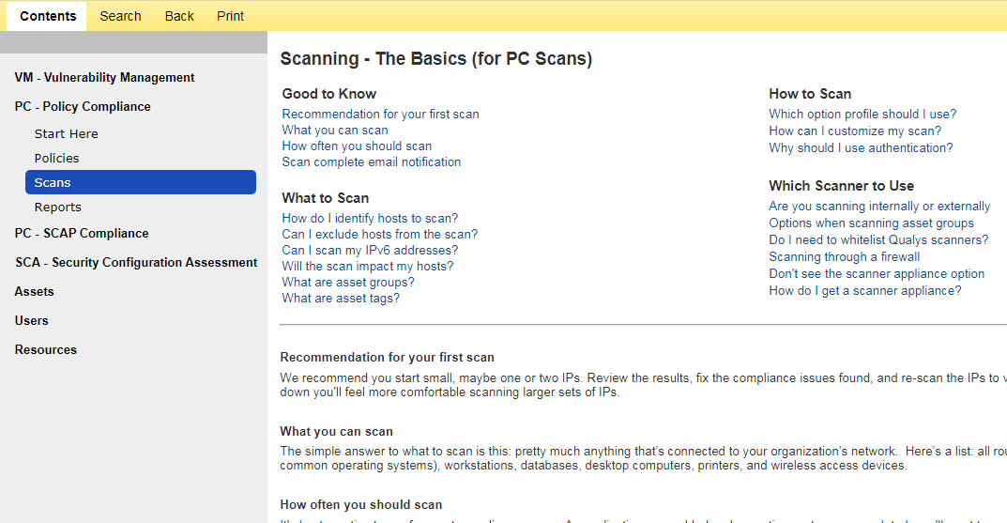
QUALYS DEMO – SECURITY HARDENING
ONLINE HELP – POLICY COMPLIANCE

Slide 8
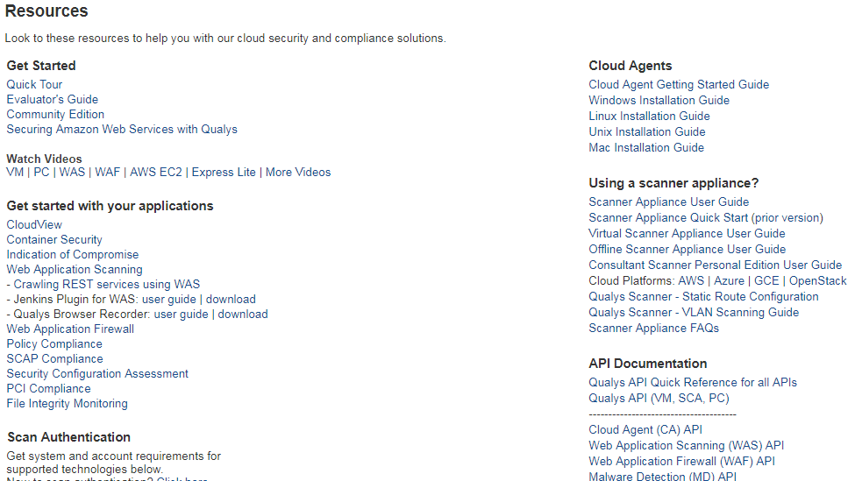
QUALYS DEMO – SECURITY HARDENING
RESOURCES

Slide 9
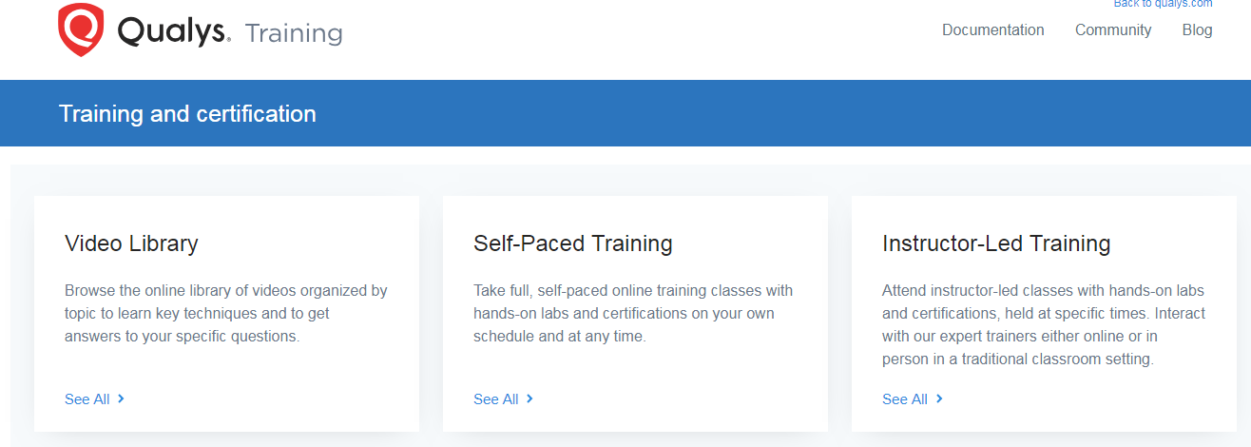
QUALYS DEMO – SECURITY HARDENING
QUALYS WEBSITE - TRAINING

Slide 10
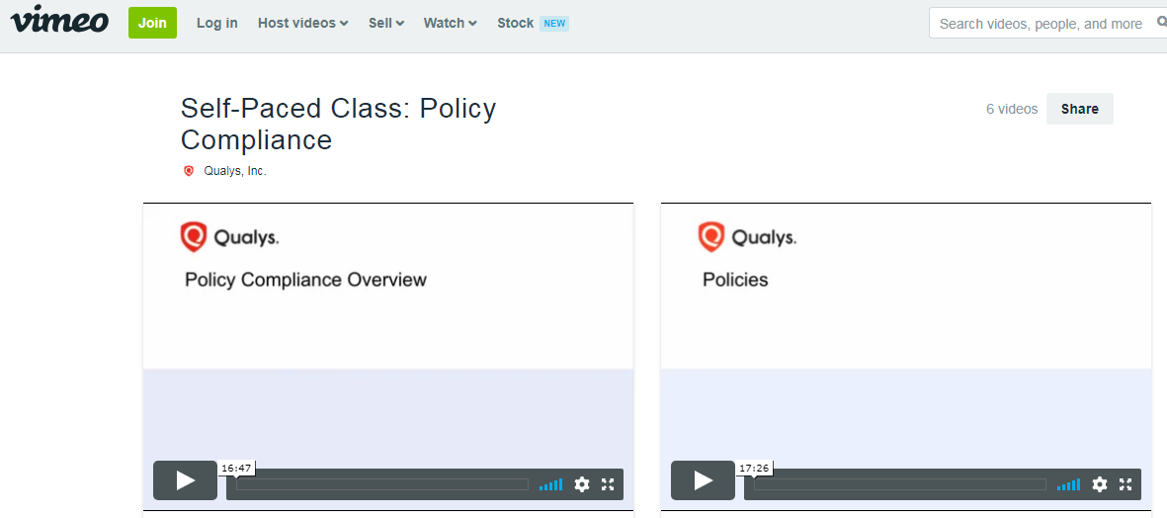
QUALYS DEMO – SECURITY HARDENING
TRAINING VIDEOS - VIMEO

Slide 11
QUALYS DEMO – SECURITY HARDENING
Qualys is an excellent tool with detailed online help, training, and resources to aid the new user
END

